Slide 1
Efficient Pseudorandom Correlation Generators from Ring-LPN
Elette Boyle, Geoffroy Couteau, Niv Gilboa,
Yuval Ishai, Lisa Kohl, and Peter Scholl
Crypto 2020

Slide 2
Synopsis
Introduction
Main Construction
Secure Setup Protocol

Slide 3
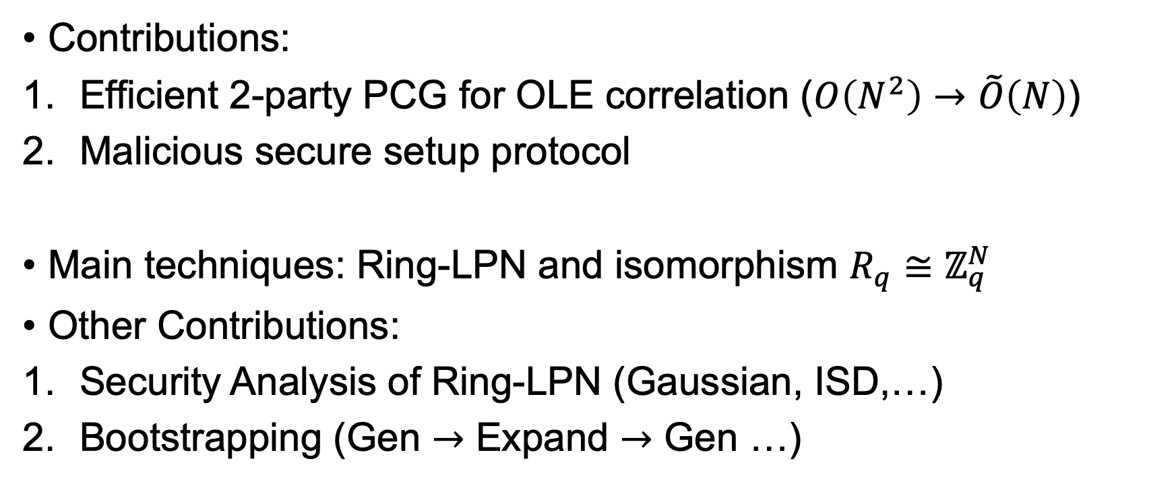
Introduction
Contributions:
Efficient 2-party PCG for OLE correlation ($O\left(N^{2}\right)→\tilde{O}\left(N\right)$)
Malicious secure setup protocol
Main techniques: Ring-LPN and isomorphism $R_{q}≅ℤ_{q}^{N}$
Other Contributions:
Security Analysis of Ring-LPN (Gaussian, ISD,…)
Bootstrapping (Gen $→$ Expand $→$ Gen …)

Slide 4
Synopsis
Introduction
Main Construction
Secure Setup Protocol

Slide 5
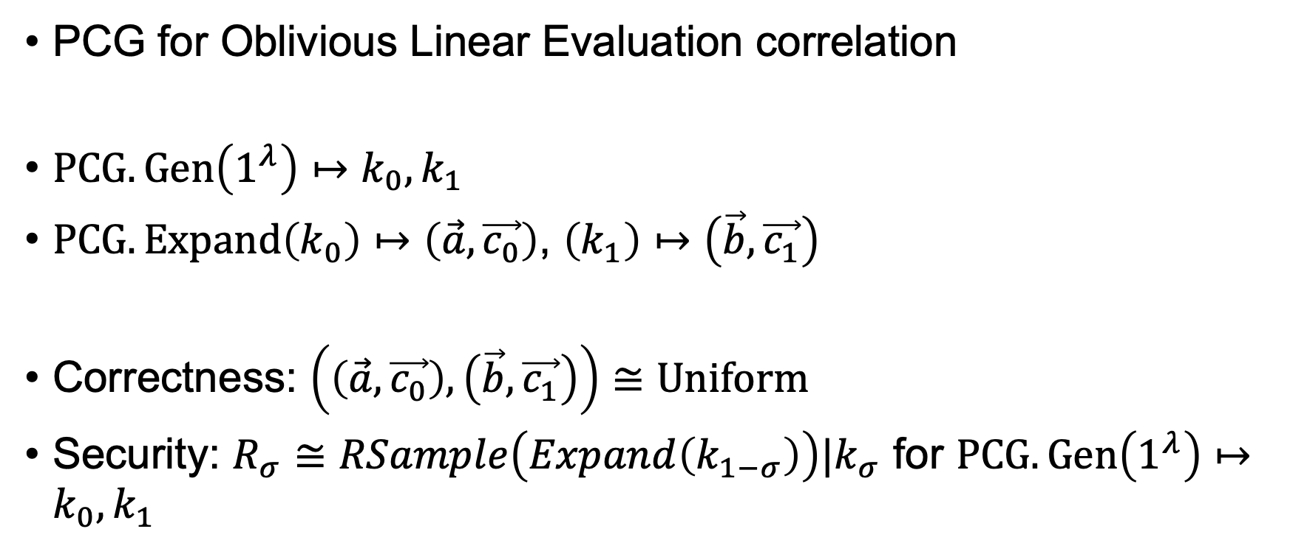
Preliminary
PCG for Oblivious Linear Evaluation correlation
$PCG.Gen\left(1^{λ}\right)↦k_{0},k_{1}$
$PCG.Expand\left(k_{0}\right)↦\left(\vec{a},\vec{c_{0}}\right)$, $\left(k_{1}\right)↦\left(\vec{b},\vec{c_{1}}\right)$
Correctness: $\left(\left(\vec{a},\vec{c_{0}}\right),\left(\vec{b},\vec{c_{1}}\right)\right)≅Uniform$
Security: $R_{σ}≅RSample\left(Expand\left(k_{1−σ}\right)\right)|k_{σ}$ for $PCG.Gen\left(1^{λ}\right)↦k_{0},k_{1}$

Slide 6

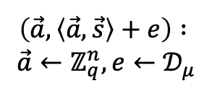
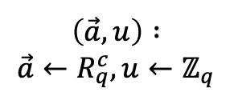
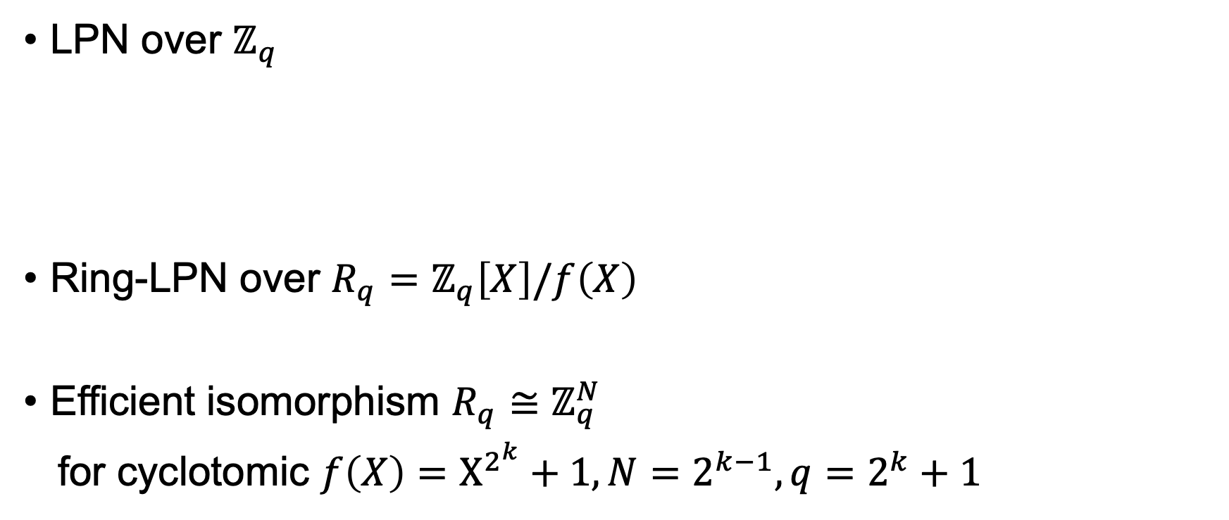
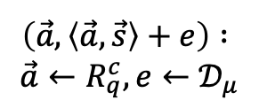

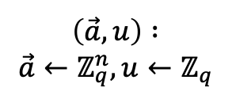
Preliminary
LPN
Oracle
Uniform Oracle
LPN over $ℤ_{q}$
Ring-LPN over $R_{q}=ℤ_{q}\left[X\right]/f\left(X\right)$
Efficient isomorphism $R_{q}≅ℤ_{q}^{N}$
for cyclotomic $f\left(X\right)=X^{2^{k}}+1,N=2^{k−1},q=2^{k}+1$
$$≅$$
$$\left(\vec{a},\left\langle \vec{a},\vec{s}\right\rangle +e\right) :$$
$$\vec{a}←ℤ_{q}^{n},e←𝒟_{μ}$$
$$\left(\vec{a},u\right) :$$
$$\vec{a}←ℤ_{q}^{n},u←ℤ_{q}$$
RLPN
Oracle
Uniform Oracle
$$≅$$
$$\left(\vec{a},\left\langle \vec{a},\vec{s}\right\rangle +e\right) :$$
$$\vec{a}←R_{q}^{c},e←𝒟_{μ}$$
$$\left(\vec{a},u\right) :$$
$$\vec{a}←R_{q}^{c},u←ℤ_{q}$$

Slide 7

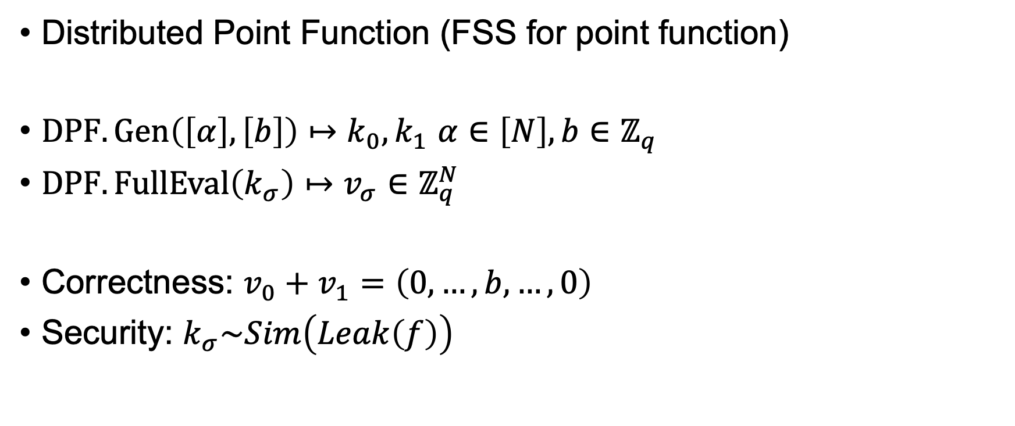
Preliminary
Distributed Point Function (FSS for point function)
$DPF.Gen\left(\left[α\right],\left[b\right]\right)↦k_{0},k_{1}$ $α∈\left[N\right],b∈ℤ_{q}$
$DPF.FullEval\left(k_{σ}\right)↦v_{σ}∈ℤ_{q}^{N}$
Correctness: $v_{0}+v_{1}=\left(0,…,b,…,0\right)$
Security: $k_{σ}\sim Sim\left(Leak\left(f\right)\right)$
$α$-th position

Slide 8


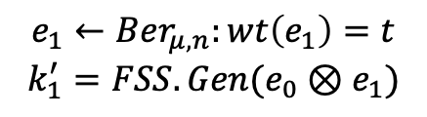
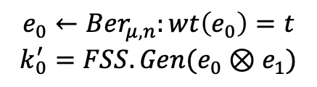
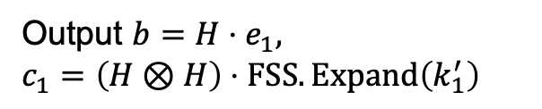
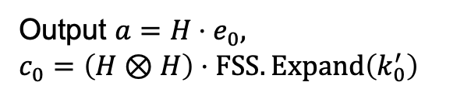


PCG for OLE
The Crypto 2019 construction for bilinear correlation :
Alice
Bob
$$e_{0}←Ber_{μ,n}:wt\left(e_{0}\right)=t$$
$$k_{0}^{′}=FSS.Gen(e_{0}⊗e_{1})$$
$$e_{1}←Ber_{μ,n}:wt\left(e_{1}\right)=t$$
$$k_{1}^{′}=FSS.Gen(e_{0}⊗e_{1})$$
$$k_{0}≔$$
$$k_{1}≔$$
Expand:
Output ${a=H⋅e}_{0},$
$$c_{0}=\left(H⊗H\right)⋅FSS.Expand\left(k_{0}^{′}\right)$$
Output ${b=H⋅e}_{1},$
$$c_{1}=\left(H⊗H\right)⋅FSS.Expand\left(k_{1}^{′}\right)$$
Problem: $H⊗H$ has $O\left(n^{4}\right)$ computational complexity

Slide 9


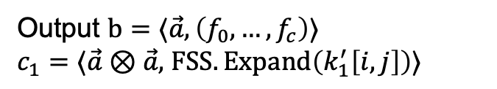
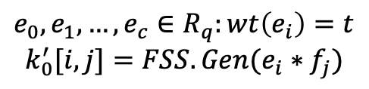
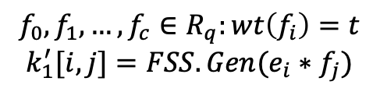
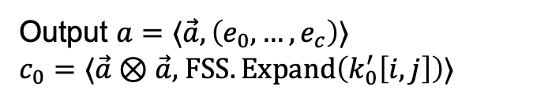
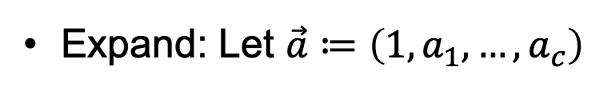
PCG for OLE
Solution: Polynomial Product and Ring-LPN
Alice
Bob
$$e_{0},e_{1},…,e_{c}∈R_{q}:wt\left(e_{i}\right)=t$$
$$k_{0}^{′}[i,j]=FSS.Gen(e_{i}∗f_{j})$$
$$f_{0},f_{1},…,f_{c}∈R_{q}:wt\left(f_{i}\right)=t$$
$$k_{1}^{′}[i,j]=FSS.Gen(e_{i}∗f_{j})$$
$$k_{0}≔$$
$$k_{1}≔$$
Expand: Let $\vec{a}≔\left(1,a_{1},…,a_{c}\right)$
Output $a=⟨\vec{a},\left(e_{0},…,e_{c}\right)⟩$
$c_{0}=⟨\vec{a}⊗\vec{a},$ $FSS.Expand\left(k_{0}^{′}\left[i,j\right]\right)⟩$
Output $b=⟨\vec{a},\left(f_{0},…,f_{c}\right)⟩$
$c_{1}=⟨\vec{a}⊗\vec{a},$ $FSS.Expand\left(k_{1}^{′}\left[i,j\right]\right)⟩$
$$FSS.Expand\left(k_{0}^{′}\left[i,j\right]\right)+FSS.Expand\left(k_{1}^{′}\left[i,j\right]\right)=\vec{e}⊗\vec{f}$$

Slide 10
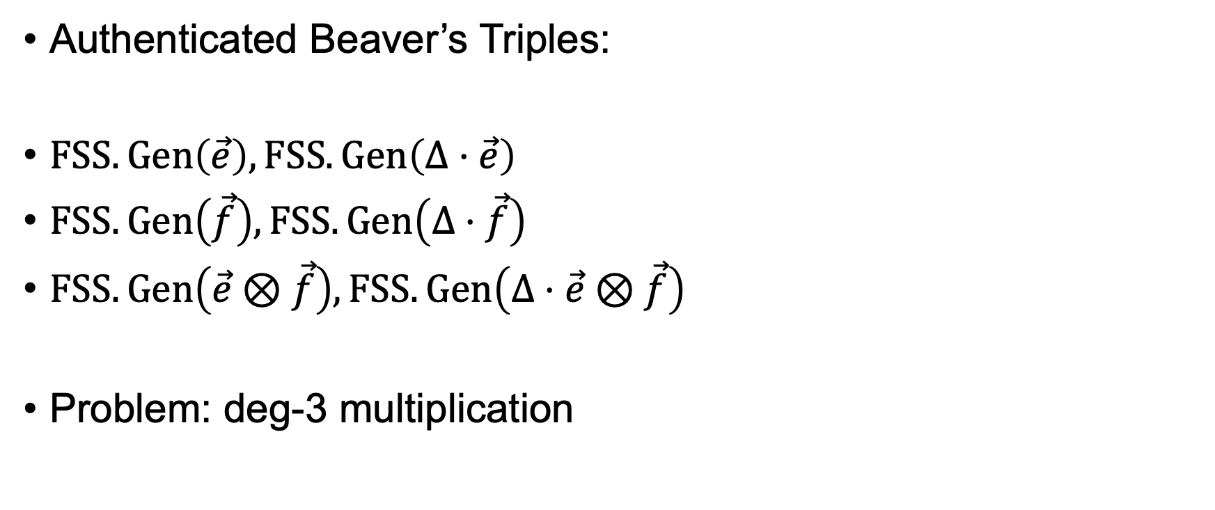
Extension
Authenticated Beaver’s Triples:
$FSS.Gen\left(\vec{e}\right),FSS.Gen\left(Δ⋅\vec{e}\right)$
$FSS.Gen\left(\vec{f}\right),FSS.Gen\left(Δ⋅\vec{f}\right)$
$FSS.Gen\left(\vec{e}⊗\vec{f}\right),FSS.Gen\left(Δ⋅\vec{e}⊗\vec{f}\right)$
Problem: deg-3 multiplication

Slide 11
Synopsis
Introduction
Main Construction
Secure Setup Protocol

Slide 12
Setup Protocol
The authors address malicious setup for OLE
Tools: Secure 2PC + [Ds17] DPF Setup
Malicious
[Ds17]
Ring-LPN
PRG
Arithmetic 2PC
Functionality
cSUV
Functionality
cOLE over R

Slide 13



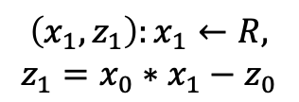





Target Functionality
Corruptible-OLE over Polynomial Ring
Honest Case
c-OLE
Functionality
$$\left(x_{0},z_{0}\right)$$
$${(x_{1},z}_{1})$$
Alice
Bob
Output $\left(x_{0},z_{0}\right)$
Output $\left(x_{1},z_{1}\right)$
Adversarial Case
$$\left(x_{0},z_{0}\right)$$
c-OLE
Functionality
$${\left(x_{1},z_{1}\right):x}_{1}←R,$$
$$z_{1}=x_{0}∗x_{1}−z_{0}$$
Alice
Bob
Reverse Sampling
Output $\left(x_{0},z_{0}\right)$
Output $\left(x_{1},z_{1}\right)$

Slide 14
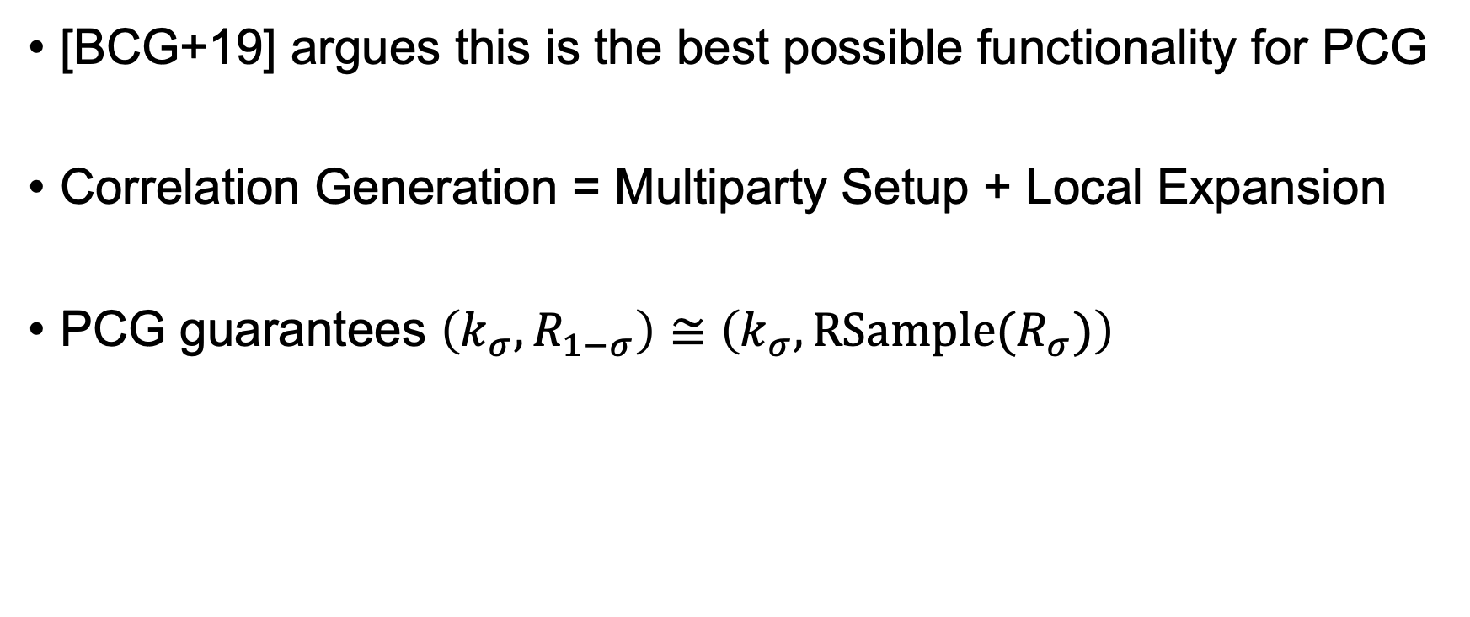
Target Functionality
[BCG+19] argues this is the best possible functionality for PCG
Correlation Generation = Multiparty Setup + Local Expansion
PCG guarantees $\left(k_{σ},R_{1−σ}\right)≅\left(k_{σ},RSample(R_{σ})\right)$

Slide 15
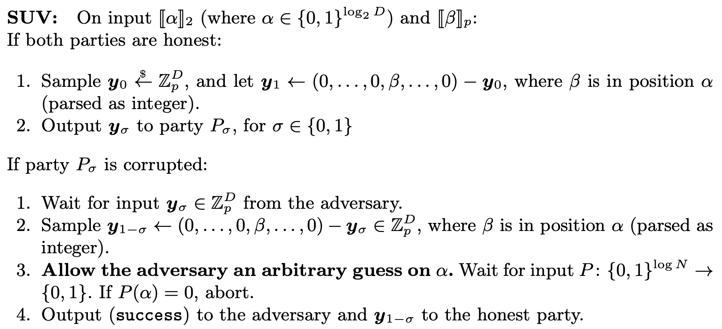
Corruptible Scaled Unit Vector Function
Selective Failure

Slide 16
Idea of [Ds17]: GGM + 2PC
Two parties evaluate a D-level GGM tree using PRG as RO
Two parties use 2PC to compute correction word at each level
PRG is evaluated outside 2PC so checking is necessary

Slide 17

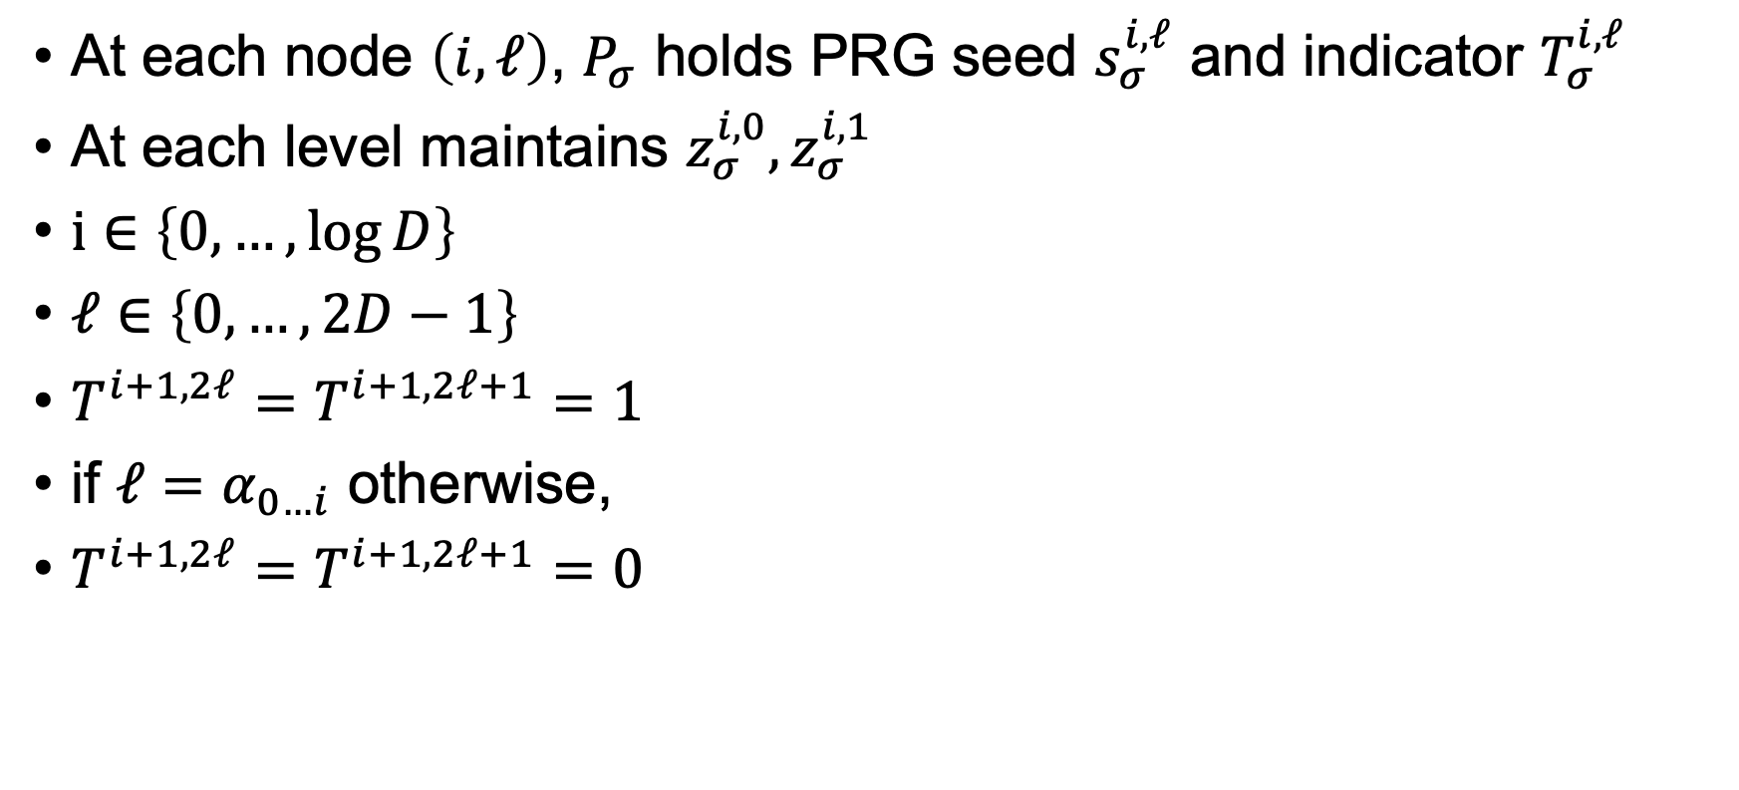



Invariants
At each node $\left(i,ℓ\right)$, $P_{σ}$ holds PRG seed $s_{σ}^{i,ℓ}$ and indicator $T_{σ}^{i,ℓ}$
At each level maintains $z_{σ}^{i,0},z_{σ}^{i,1}$
$i∈\left\{0,…,\log{D}\right\}$
$ℓ∈\left\{0,…,2D−1\right\}$
$T^{i+1,2ℓ}=T^{i+1,2ℓ+1}=1$
if $ℓ=α_{0…i}$ otherwise,
$T^{i+1,2ℓ}=T^{i+1,2ℓ+1}=0$
$$ε$$
$$α_{0}=1$$
0,0
0,1
$$α_{1}=0$$
1,0
1,1
1,2
1,3
$$α_{2}=1$$
2,0
2,1
2,2
2,3
2,4
2,5
2,6
2,7

Slide 18
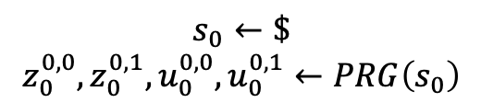





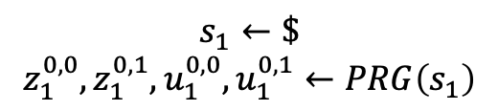

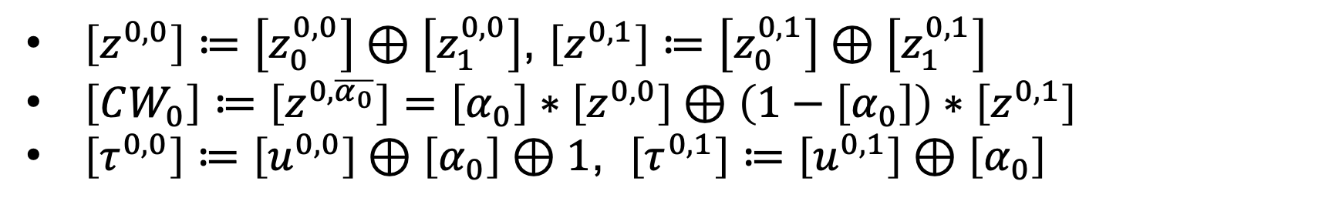
Distributed Setup, Level 0
$$P_{0}$$
$$P_{1}$$
$$s_{0}←\$$$
$$z_{0}^{0,0},z_{0}^{0,1},u_{0}^{0,0},u_{0}^{0,1}←PRG\left(s_{0}\right)$$
$$s_{1}←\$$$
$$z_{1}^{0,0},z_{1}^{0,1},u_{1}^{0,0},u_{1}^{0,1}←PRG\left(s_{1}\right)$$
$$ε$$
$$ε$$
$$α_{0}=1$$
0,0
0,1
0,0
0,1
$$α_{1}=0$$
1,0
1,1
1,2
1,3
1,0
1,1
1,2
1,3
$$α_{2}=1$$
2,0
2,1
2,2
2,3
2,4
2,5
2,6
2,7
2,0
2,1
2,2
2,3
2,4
2,5
2,6
2,7
$\left[z^{0,0}\right]≔\left[z_{0}^{0,0}\right]⊕\left[z_{1}^{0,0}\right]$, $\left[z^{0,1}\right]≔\left[z_{0}^{0,1}\right]⊕\left[z_{1}^{0,1}\right]$
$\left[CW_{0}\right]≔\left[z^{0,\overline{α_{0}}}\right]=\left[α_{0}\right]∗\left[z^{0,0}\right]⊕\left(1−\left[α_{0}\right]\right)∗\left[z^{0,1}\right]$
$\left[τ^{0,0}\right]≔\left[u^{0,0}\right]⊕\left[α_{0}\right]⊕1$, $\left[τ^{0,1}\right]≔\left[u^{0,1}\right]⊕\left[α_{0}\right]$
Compute
w/ 2PC

Slide 19
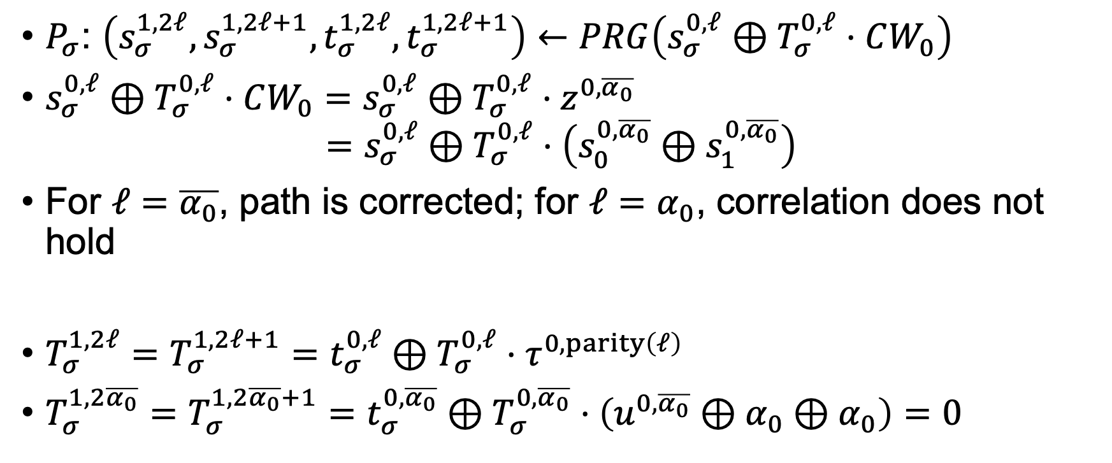
Analysis of Distributed Setup, Level 0
$P_{σ}$: $\left(s_{σ}^{1,2ℓ},s_{σ}^{1,2ℓ+1},t_{σ}^{1,2ℓ},t_{σ}^{1,2ℓ+1}\right)←PRG\left(s_{σ}^{0,ℓ}⊕T_{σ}^{0,ℓ}⋅CW_{0}\right)$
$s_{σ}^{0,ℓ}⊕T_{σ}^{0,ℓ}⋅CW_{0}=s_{σ}^{0,ℓ}⊕T_{σ}^{0,ℓ}⋅z^{0,\overline{α_{0}}}$
$$=s_{σ}^{0,ℓ}⊕T_{σ}^{0,ℓ}⋅\left(s_{0}^{0,\overline{α_{0}}}⊕s_{1}^{0,\overline{α_{0}}}\right)$$
For $ℓ=\overline{α_{0}}$, path is corrected; for $ℓ=α_{0}$, correlation does not hold
$T_{σ}^{1,2ℓ}=T_{σ}^{1,2ℓ+1}=t_{σ}^{0,ℓ}⊕T_{σ}^{0,ℓ}⋅τ^{0,parity\left(ℓ\right)}$
$T_{σ}^{1,2\overline{α_{0}}}=T_{σ}^{1,2\overline{α_{0}}+1}=t_{σ}^{0,\overline{α_{0}}}⊕T_{σ}^{0,\overline{α_{0}}}⋅\left(u^{0,\overline{α_{0}}}⊕α_{0}⊕α_{0}\right)=0$

Slide 20
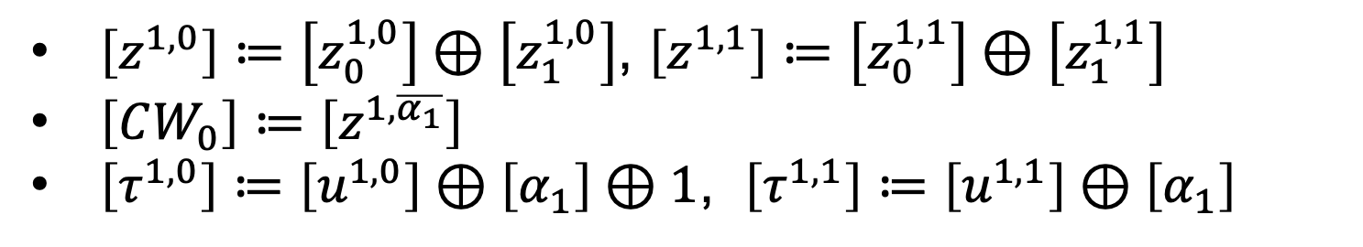

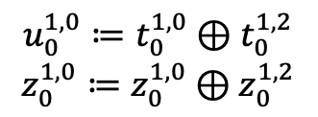

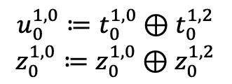

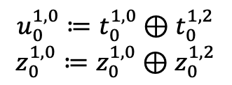



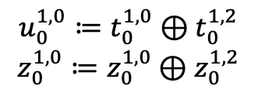


Distributed Setup, Level 1
$$P_{0}$$
$$P_{1}$$
$$u_{0}^{1,0}≔t_{0}^{1,0}⊕t_{0}^{1,2}$$
$$z_{0}^{1,0}≔z_{0}^{1,0}⊕z_{0}^{1,2}$$
$$u_{0}^{1,0}≔t_{0}^{1,0}⊕t_{0}^{1,2}$$
$$z_{0}^{1,0}≔z_{0}^{1,0}⊕z_{0}^{1,2}$$
$$u_{0}^{1,0}≔t_{0}^{1,0}⊕t_{0}^{1,2}$$
$$z_{0}^{1,0}≔z_{0}^{1,0}⊕z_{0}^{1,2}$$
$$u_{0}^{1,0}≔t_{0}^{1,0}⊕t_{0}^{1,2}$$
$$z_{0}^{1,0}≔z_{0}^{1,0}⊕z_{0}^{1,2}$$
$$ε$$
$$ε$$
$$α_{0}=1$$
0,0
0,1
0,0
0,1
$$t_{0}^{1,0},s_{0}^{1,0}$$
$$t_{0}^{1,1},s_{0}^{1,1}$$
$$t_{0}^{1,2},s_{0}^{1,2}$$
$$t_{0}^{1,3},s_{0}^{1,3}$$
$$t_{1}^{1,0},s_{1}^{1,0}$$
$$t_{1}^{1,1},s_{1}^{1,1}$$
$$t_{1}^{1,2},s_{1}^{1,2}$$
$$t_{1}^{1,3},s_{1}^{1,3}$$
$$α_{1}=0$$
1,0
1,1
1,2
1,3
1,0
1,1
1,2
1,3
$$α_{2}=1$$
2,0
2,1
2,2
2,3
2,4
2,5
2,6
2,7
2,0
2,1
2,2
2,3
2,4
2,5
2,6
2,7
$\left[z^{1,0}\right]≔\left[z_{0}^{1,0}\right]⊕\left[z_{1}^{1,0}\right]$, $\left[z^{1,1}\right]≔\left[z_{0}^{1,1}\right]⊕\left[z_{1}^{1,1}\right]$
$\left[CW_{0}\right]≔\left[z^{1,\overline{α_{1}}}\right]$
$\left[τ^{1,0}\right]≔\left[u^{1,0}\right]⊕\left[α_{1}\right]⊕1$, $\left[τ^{1,1}\right]≔\left[u^{1,1}\right]⊕\left[α_{1}\right]$
Compute
w/ 2PC

Slide 21
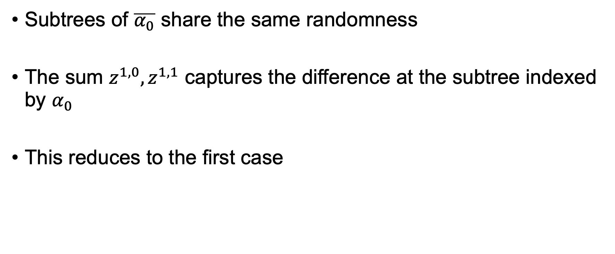
Analysis of Distributed Setup, Level 1
Subtrees of $\overline{α_{0}}$ share the same randomness
The sum $z^{1,0},z^{1,1}$ captures the difference at the subtree indexed by $α_{0}$
This reduces to the first case

Slide 22
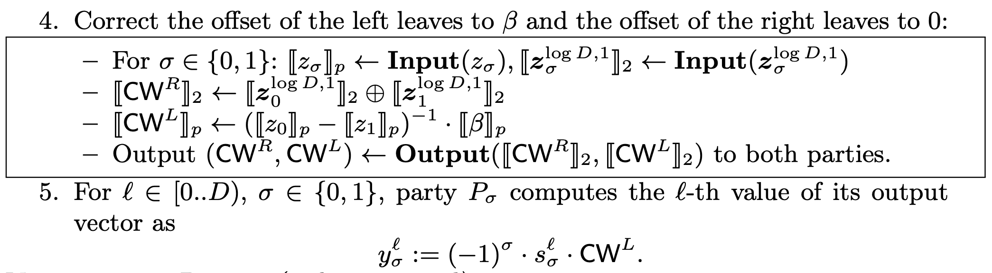


Distributed Setup, Level $\log{D}$
After level $\left(\log{D}−1\right)$, the parties hold $s^{\log{D},∗},t^{\log{D},∗},T^{\log{D},∗}$
Use the left leaves for output, right leaves for checking

Slide 23
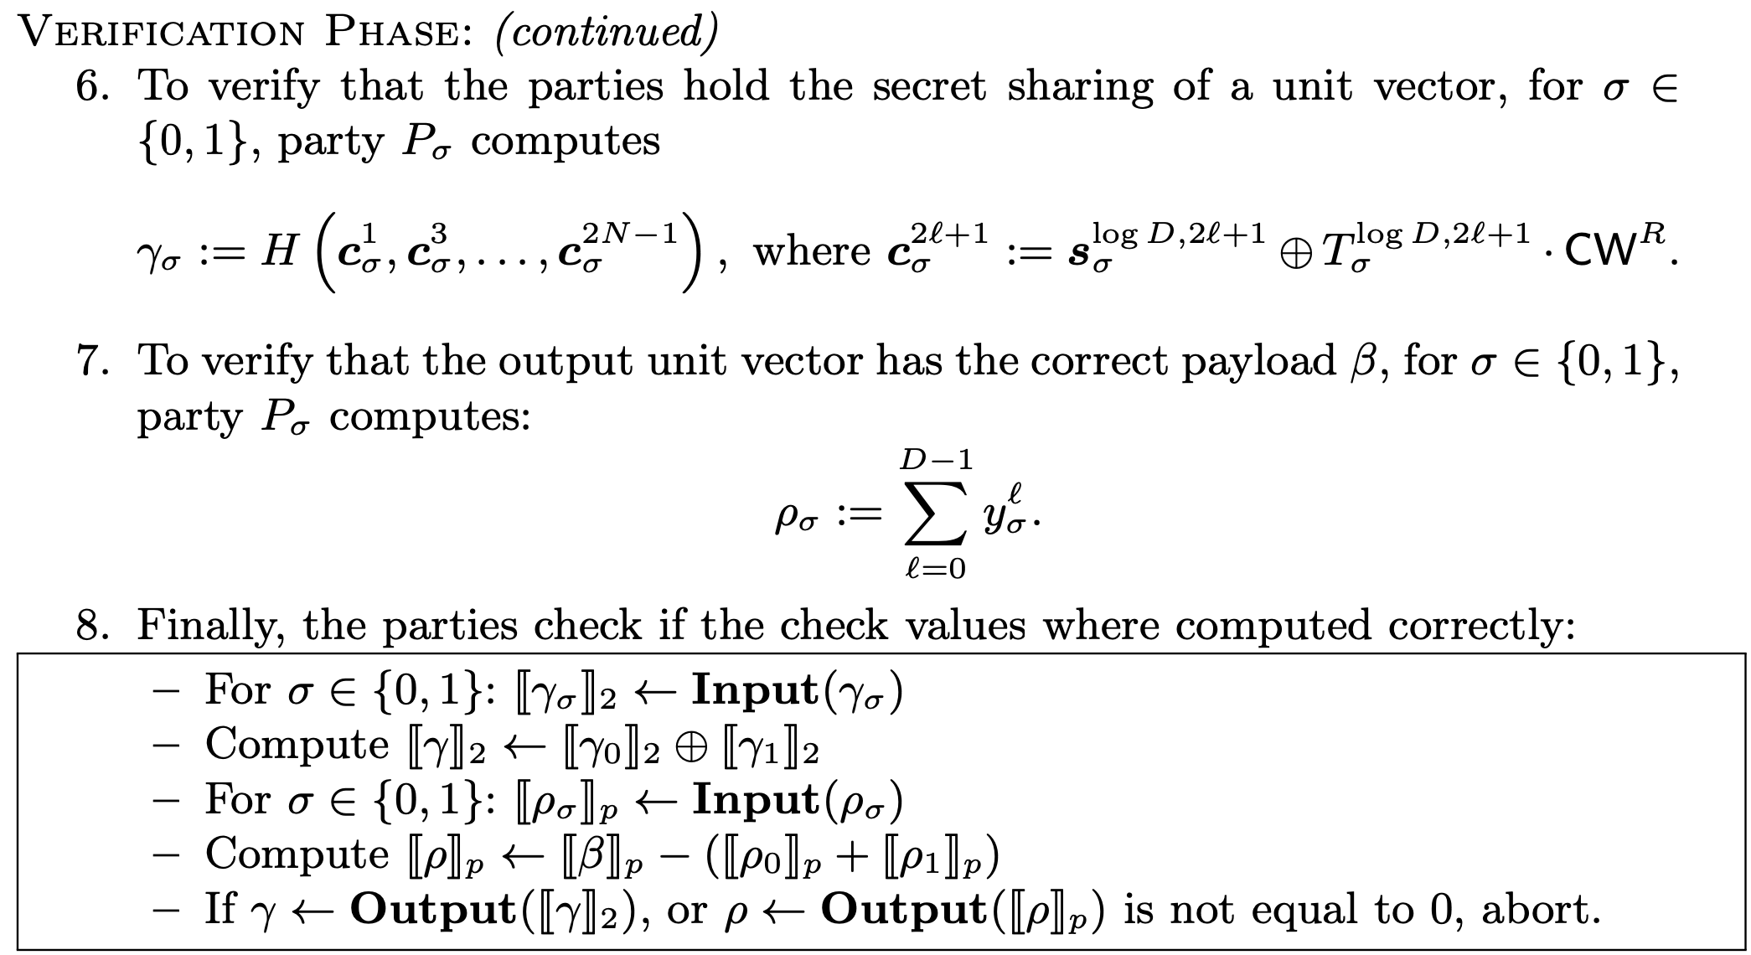
Checking

Slide 24

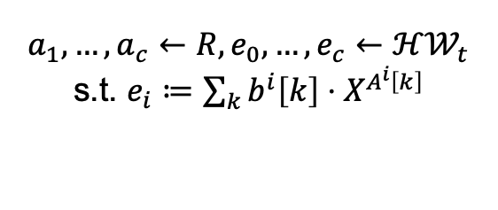






Ring-LPN with Static Leakage
Using c-SUV still allows the adversary to guess honest parties LPN noise
We model this using a stronger definition
RLPN w/ L
Oracle
Uniform Oracle
$$≅$$
Adversary
$$a_{1},…,a_{c}←R, e_{0},…,e_{c}←ℋ𝒲_{t}$$
s.t. $e_{i}≔\sum_{k}{b^{i}\left[k\right]⋅X^{A^{i}\left[k\right]}}$
$$P_{k}^{i}:\left[0,N\right)→\left\{0,1\right\}$$
Abort if $P_{k}^{i}\left(A^{i}\left[k\right]\right)=0$
$$Success$$
$$u_{0}≔\left\langle \vec{a},\vec{e}\right\rangle$$
$$u_{1}←R$$
$$u_{b}$$
Guesses b

Slide 25
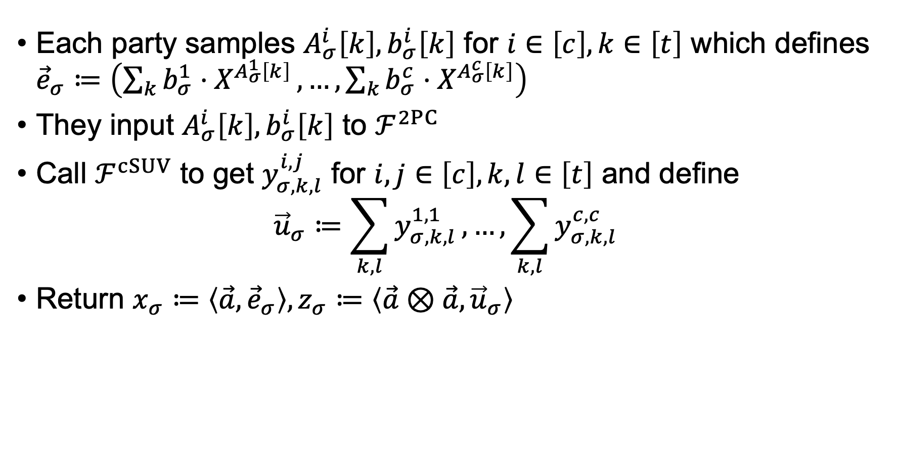
Corruptible OLE Protocol
Each party samples $A_{σ}^{i}\left[k\right],b_{σ}^{i}\left[k\right]$ for $i∈\left[c\right],k∈\left[t\right]$ which defines ${\vec{e}}_{σ}≔\left(\sum_{k}{b_{σ}^{1}⋅X^{A_{σ}^{1}\left[k\right]}},…,\sum_{k}{b_{σ}^{c}⋅X^{A_{σ}^{c}\left[k\right]}}\right)$
They input $A_{σ}^{i}\left[k\right],b_{σ}^{i}\left[k\right]$ to $ℱ^{2PC}$
Call $ℱ^{cSUV}$ to get $y_{σ,k,l}^{i,j}$ for $i,j∈\left[c\right],k,l∈\left[t\right]$ and define
$${\vec{u}}_{σ}≔\sum_{k,l}{y_{σ,k,l}^{1,1}},…,\sum_{k,l}{y_{σ,k,l}^{c,c}}$$
Return $x_{σ}≔\left\langle \vec{a},{\vec{e}}_{σ}\right\rangle , z_{σ}≔\left\langle \vec{a}⊗\vec{a},{\vec{u}}_{σ}\right\rangle$

Slide 26






Security in the 2PC, cSUV-hybrid Model
Alice
Bob
Generates $A_{0}^{i}\left[k\right]$
2PC
Generates $A_{1}^{i}\left[k\right]$
$$A^{i}\left[k\right]≔A_{0}^{i}\left[k\right]+A_{1}^{i}\left[k\right]$$
$$b^{i}\left[k\right]≔b_{0}^{i}\left[k\right]+b_{1}^{i}\left[k\right]$$
SUV
$$\left(y_{0,k,l}^{i,j},y_{1,k,l}^{i,j}\right)←Gen\left(\begin{aligned}A^{i}\left[k\right]+A^{j}\left[l\right], \\ b^{i}\left[k\right]+b^{j}\left[l\right]\end{aligned}\right)$$
$$P:\left[0,2N\right)→\left\{0,1\right\}$$
$$Q:\left[0,N\right)→\left\{0,1\right\}$$
Leakage on R-LPN Secret !

Slide 27
Security in the 2PC, cSUV-hybrid Model
Thus the security reduces to the Ring-LPN assumption with static leakage
LPN is inherently leakage-resilient, but the concrete parameters settings are not investigated

